Slide 1


CCNA [ Cisco Device Management ]
Presented by: [ Ali Karimi, Zahra Jenabzadeh ]
Course Professor: Dr. Seyedreza Taghizadeh

Slide 2
To be considered charitable …
We are aimed at sharing our science in a collaborative learning environment for the advancement of the education of the public in the subject of Information Technology. So, feel free to share this video!

Slide 3
We are going to cover:
1 – [Router] Factory Reset
2 – [Router] Password Recovery
3 – [Router] Configuration Backup
4 - IOS System Image Backup & Recovery
5 - IOS Image Upgrade

Slide 4
Stuck in networks problem? Escape ways are incoming!
Have you ever forgot password ? Encountered a chronic problem and only remained way was restore device to last normal point ? What about neccesary updates ?
Sadly, Routers can also be the subject of these problems, So we are going to talk about it!

Slide 5
Factory Reset

Slide 6
Factory Reset
In some situations we need to reset router to factory settings
In this part we take a hand on it

Slide 7
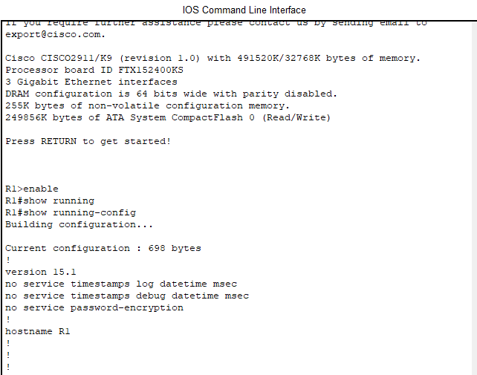
Factory Reset
First we take a look at Running configuration on router R1

Slide 8
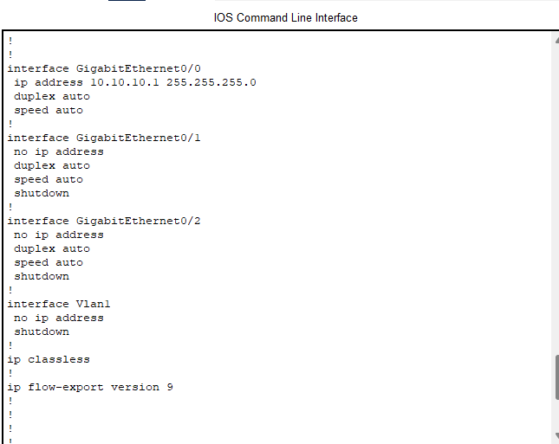
Factory Reset
First we take a look at Running configuration on router R1

Slide 9
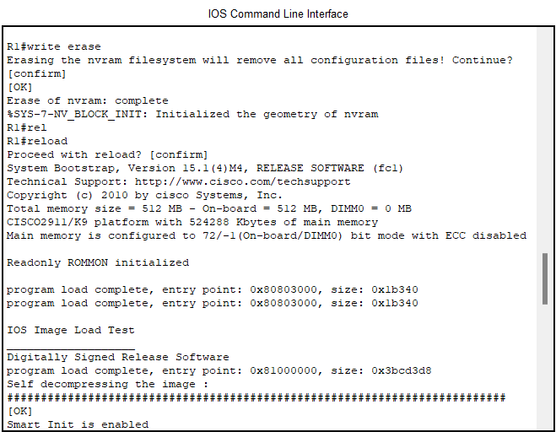
Factory Reset
Delete whole configuration files then reboot!

Slide 10
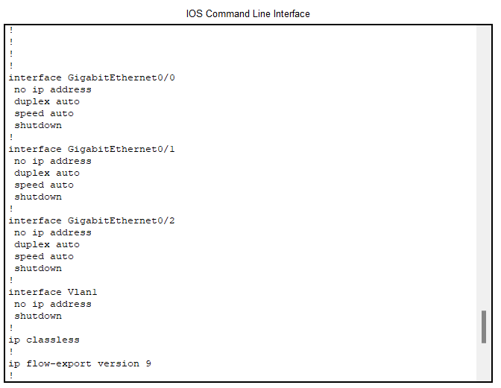
Factory Reset
Check running configuration after reset.
It’s empty now!

Slide 11
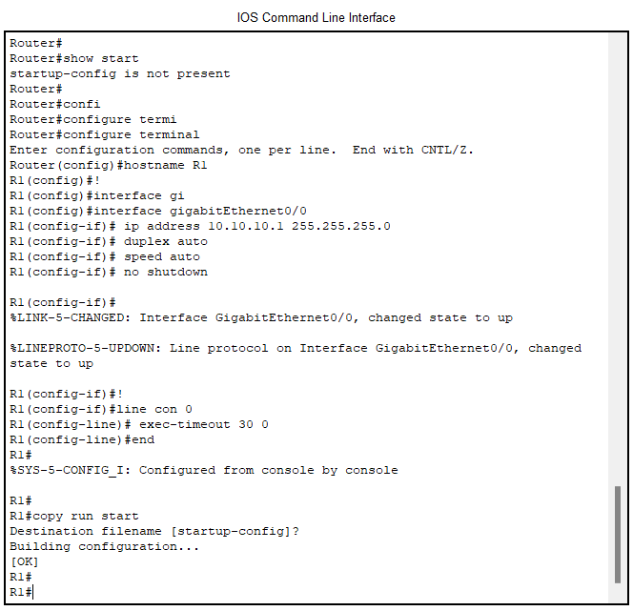
Factory Reset
Finally, reconfigure router R1 and set this new configuration as startup configuration

Slide 12
Password Recovery

Slide 13
Password Recovery
If we forget router password we need to recover/delete password
In this part we take a hand on it

Slide 14
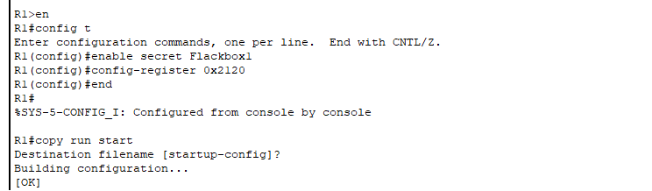
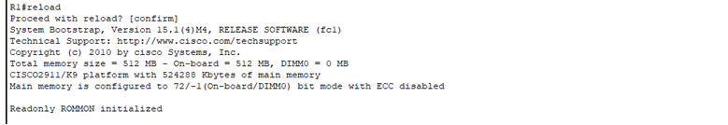
Password Recovery
First we need to switch to configuration mode, So that we can set the password to “Flackbox1” on router R1.
Then we have to configure the router to boot into the ROMMON prompt after we reload the router

Slide 15
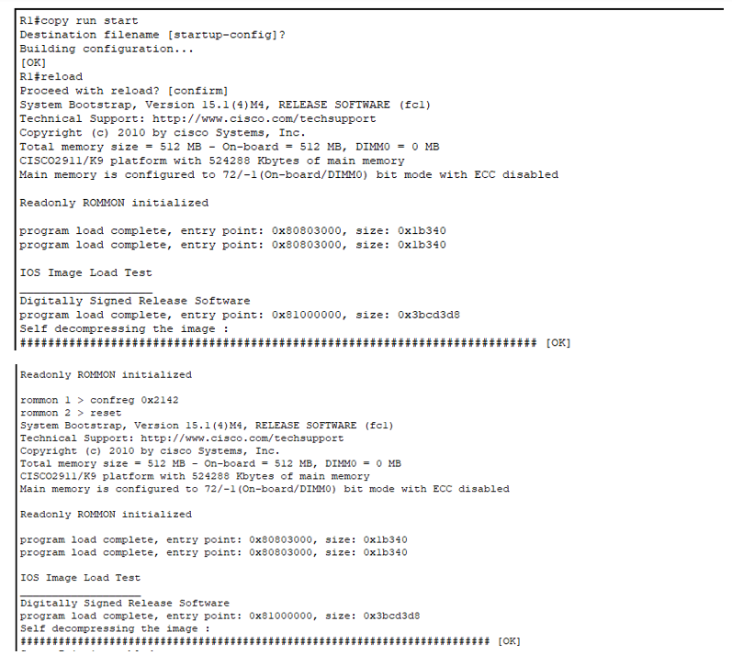
Password Recovery
Now we entered ROMMON, we configure the router to ignore the start-up configuration when booting up, then we reload the router.
As result, the router should now boot into the setup wizard, then we exit the wizard.

Slide 16
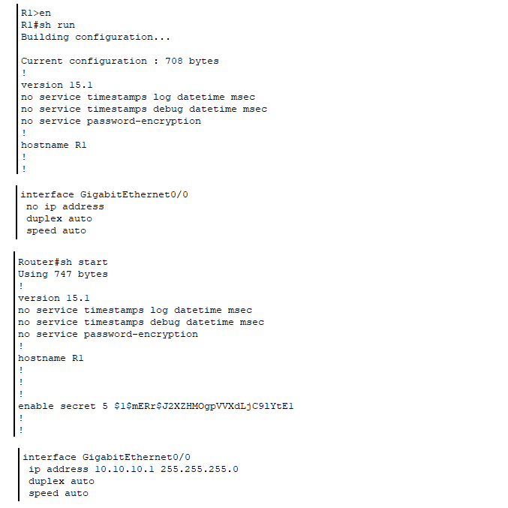
Password Recovery
The running configuration should be empty because the router bypassed loading the startup config on boot up.
The startup config should remain unchanged and all previous configuration should still be there.

Slide 17
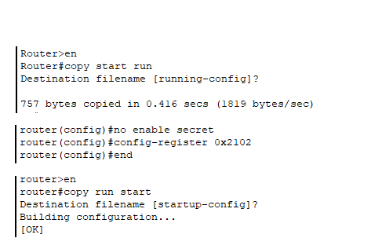
Password Recovery
We have to copy the start-up config to running config to avoid router get factory reset.
Now we remove the enable secret (aka password) and ensure the router will reboot normally on the next reload and we will be able to access the router

Slide 18
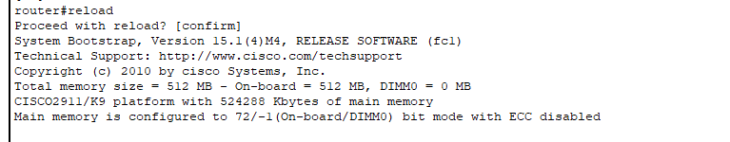
Password Recovery
At the end we reboot the router to confirm the result and as we can see the password has been removed from the router

Slide 19
Configuration Backup

Slide 20
Configuration Backup
It’s always a good idea to Backup router’s configuration for later situation that we need to restore normal configuration
In this part we take a hand on it

Slide 21
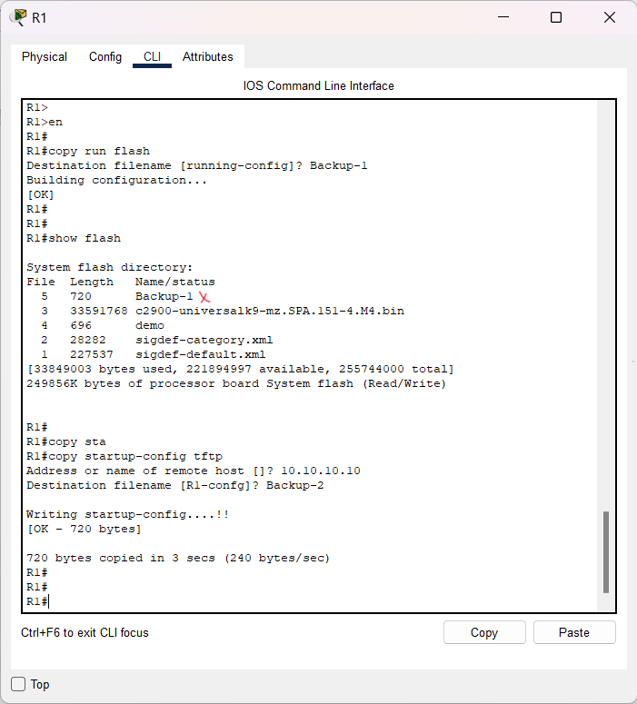
Configuration Backup
We do copy running configuration to router’s flash memory & start up configuration to TFTP server. What would be “Backing up” except make copies ?

Slide 22
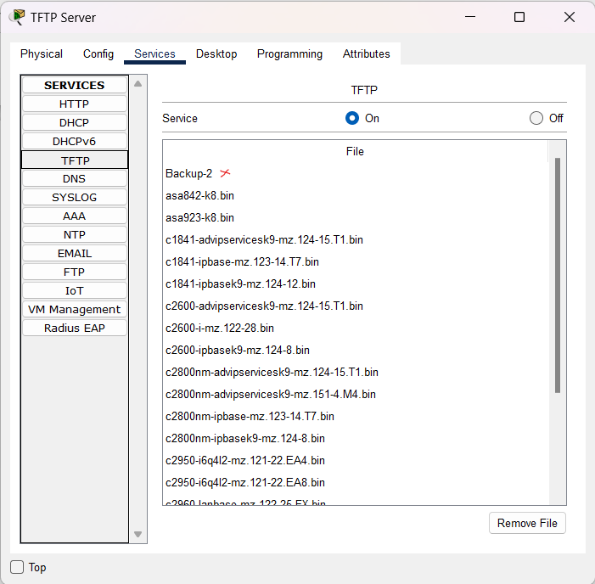
Configuration Backup
As expected, TFTP server stores router R1’s startup configuration as “Backup-2”.

Slide 23
IOS System Image Backup and Recovery

Slide 24
IOS System Image Backup and Recovery
IOS (Internetwork operating system) is cisco routers operating system.
We can also backup it for further critical situations
In this part we take a hand on it

Slide 25
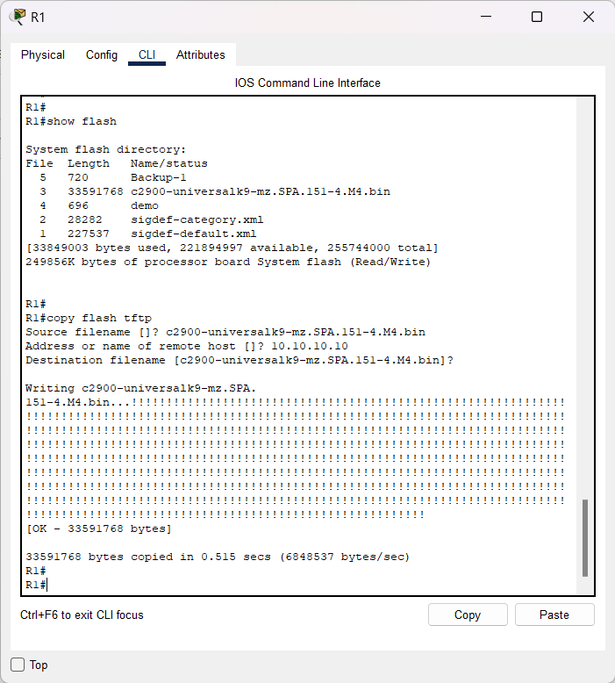
IOS System Image Backup and Recovery
First of all, let’s take a look at router’s flash memory. Then copy IOS image file from flash memory to TFTP server

Slide 26
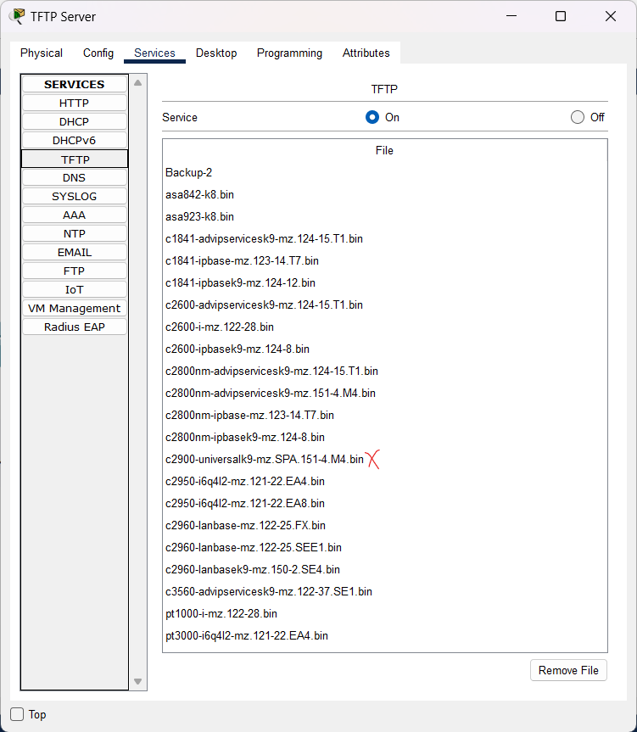
IOS System Image Backup and Recovery
TFTP server received sent file and stored that.
Verification done!

Slide 27
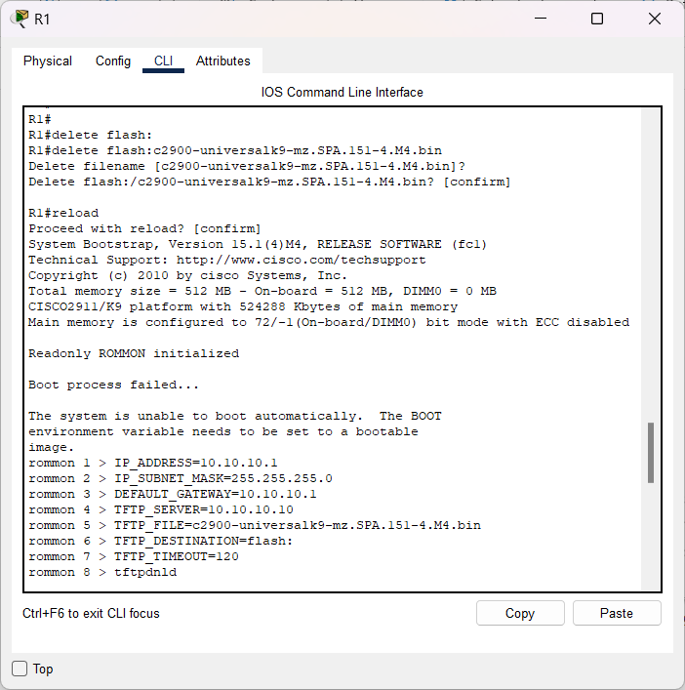
IOS System Image Backup and Recovery
It’s time to make crisis on purpose!
Delete IOS image file in flash memory and reboot router. Router faced boot fail and we need to configure it in rommon( ROM Monitor) mode to boot automatically.

Slide 28
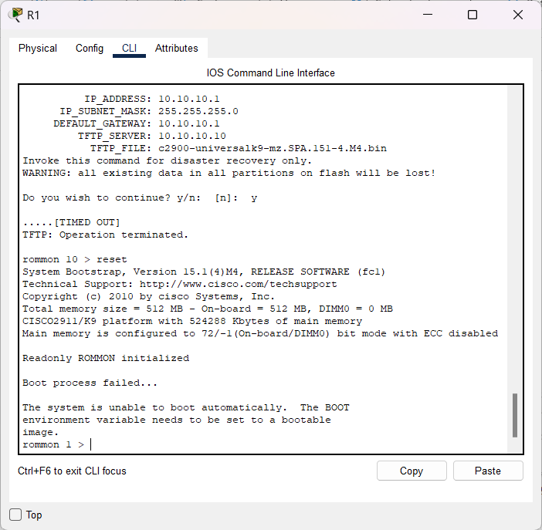
IOS System Image Backup and Recovery
We set basics for router ( IP, Subnet mask, TFTP server and File should received from TFTP) then order to download IOS image backup from TFTP server which we stored earlier ( BUT it will be failed as expected!)

Slide 29
IOS Image Upgrade

Slide 30
IOS Image Upgrade
IOS (Internetwork operating system) is cisco routers operating system.
Upgrade IOS image as other upgrades results in better utility so we can do it on our network’s switch.
In this part we take a hand on it

Slide 31
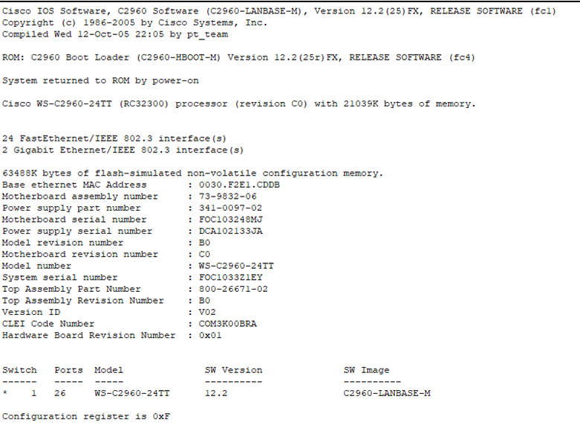
IOS Image Upgrade
First we verify the version of current switch. As we can see it is 12.2
Now we want to upgrade it.

Slide 32
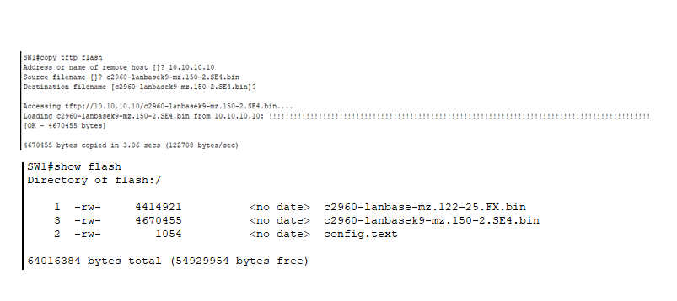
IOS Image Upgrade
then we use tftp server to upgrade our source file in flash
also our host address is the address of router: 10.10.10.10
using show flash command we can see a new file” c2960-lanbasek9-mz.150-2.SE4.bin” is added to the router flash memory.

Slide 33
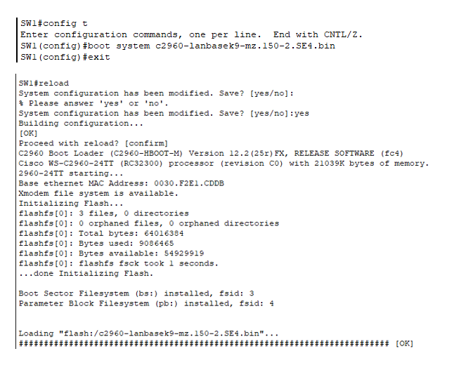
IOS Image Upgrade
then we switch to configuration mode to boot the system from the new added file in flash
We reboot the system to save the changes

Slide 34
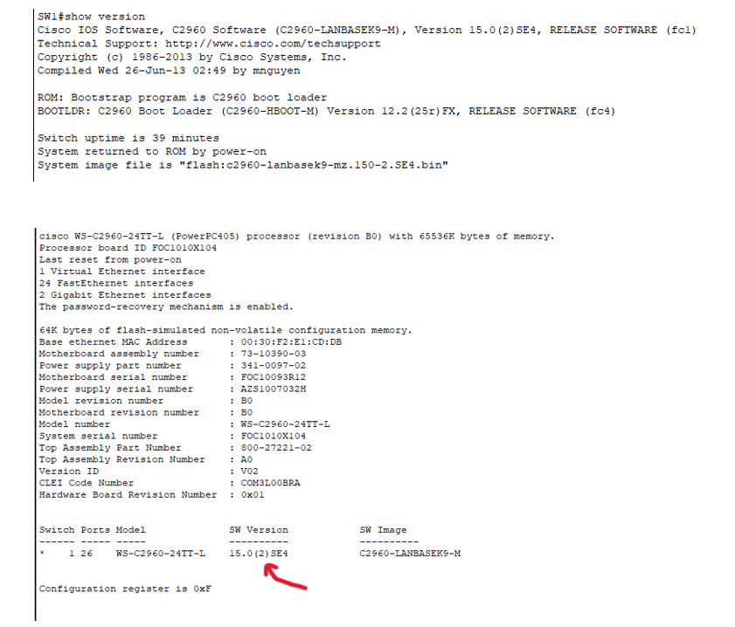
IOS Image Upgrade
Using show version command we can see that the switch is running the new software version (15.0)

Slide 35
List of the commands
Router Factory Reset :
R1#sh run (Show run) : shows router R1’s running configuration
R1#write erase : removes router R1’s configuration file
R1#reload : reboots router R1
R1#show start : shows router R1’s start up configuration\
R1#configure terminal(conf t) : enter configure mode of router R1
R1#copy run start : copies router R1’s running configuration to start up configuration

Slide 36
List of the commands
Password Recovery :
R1#config t : enter configuration table
R1#reload (rommon>reset): reboots router R1
R1#copy run start : copies router R1’s running configuration to startup configuration

Slide 37
List of the commands
Configuration backup :
R1#show flash : shows router R1’s flash memory
R1#copy startup-config tftp : copies router R1’s startup configuration to TFTP server’s storage
R1#copy run flash : copies router R1’s running configuration to router’s flash memory

Slide 38
List of the commands
IOS System Image Backup and Recovery :
R1#delete flash: file : delete file from router’s flash memory
R1#copy flash tftp : copies router R1’s running configuration to router’s flash memory

Slide 39
List of the commands
IOS Image Upgrade:
R1#show version : shows detailed information about software running on switch

Slide 40
THANK YOU!

Slide 41
YOU CAN SPLIT YOUR CONTENT
This is just a sample text to show you what a paragraph looks like in this presentation. This text is not a guide.
This is just a sample text to show you what a paragraph looks like in this presentation. This text is not a guide
This is just a sample text to show you what a paragraph looks like in this presentation. This text is not a guide.
This is just a sample text to show you what a paragraph looks like in this presentation. This text is not a guide

